Slide 1
Day 4 (MM/DD/YYYY)
D-Code

Slide 2
Welcome!

Slide 3
Standup
Block & Inline Elements
About CSS
CSS Style Precedence
Style a Sample Page

Slide 4
try{whatDoYouRemember();}
Notes:
Do all elements have opening and closing tags? (No) What do you call elements that don’t? (empty elements)
What’s an example of an empty element? (img)
What is structural HTML for? Don’t use the word structure. (Describing where items are on a page)
What does semantic HTML describe? (The amount of emphasis on words, the meaning of things on the page)
How do you access a file in the same folder? file.ext
How about one in a folder within that same folder? foldername/file.ext
How about one in a parent folder? ../file.ext

Slide 5
Block & Inline Elements

Slide 6
Block Elements
Elements that always look like they start on a new line are called block elements.
Examples:
<h1>
<p>
<ul>
<li>

Slide 7
Inline Elements
Elements that appear to continue on the same line are called inline elements.
Examples:
<em>
<img>

Slide 8
Block & Inline Elements
We’ll look at two specific elements:
div and span

Slide 9
<div></div>
a block element
abbreviation for “division”
Used to group elements together in a block-level “box”
Separates information it encloses from everything else
Might be used for header, or to separate contents logically

Slide 10
<span></span>
An inline element
Used to group elements on one line together
Usually used to make some items appear a certain way with CSS
Example: use span within a <p> element

Slide 11
try{useDiv();}
Open HelloWorldHTML.html
Create a div tag with an id of “header” to surround the first three elements
<body> <div id=“header”> <h1 align=“center”>Hello World!!</h1> <h2>by: (your name here)</h2> <p>You just wrote a webpage using HTML at
<a href=http://www.detroitedisonpsa.org>DEPSA</a> </p> </div>
</body>
Notes:
Have students open HelloWorldHTML.html for this and the following exercises.
Students should add the div tag to the div already on the page.
The color highlighted portions are what the students should focus on. The rest of the code is only for reference.

Slide 12
try{useDiv();}
What happens on the web page when you’ve made this change?
Now try adding the attribute style=“background:#FF0000;” to the <div>. What changes?
Notes:
Students should add the attribute to the div with the ”header” tag. Make sure students add a semi-colon inside the quotation.

Slide 13
try{useSpan();}
Create a span tag with an id of “wrotepage” to surround the words “wrote a webpage using HTML”.
<p>You just <span id=“wrotepage”>wrote a webpage using HTML</span> at <a href=http://www.detroitedisonpsa.org>DEPSA</a> </p>
Notes:
Have students add the id to the span on the HelloWorldHTML.html document they have

Slide 14
try{useSpan();}
What happens on the web page when you’ve made this change?
Now try adding the attribute style=“color:#0000FF;” to the <span>. What changes?
Notes:
Students will add the attribute to the same <span> tag in the previous slide. Make sure students at semi-colon inside the quotation.

Slide 15
try{useCss();}
There are a lot of steps, so hold on!!
Now delete the style attributes you just added to <div> and <span>.
Open a new document.
Write the following:
Notes:
Remind the students to only delete the attributes and their values.

Slide 16
try{useCss();}
#header { background-color: red; } #wrotepage { color: green; }

Slide 17
try{useCss();}
Go to File > Save As…
Create a folder called css in the same folder that holds helloWorldHTML.html.
Inside this css folder, save the document as helloWorldHTML-stylesheet.css .
Notes:
Remind students that files paths are case sensitive.
Path: css/index-stylesheet.css

Slide 18
try{useCss();}
Go back to index.html.
Add <link href=“css/helloWorldHTML-stylesheet.css” rel=“stylesheet”> to the <head> element.
Save the document.
Refresh the page (helloWorldHTML.html) in the browser.
What happens? Discuss.

Slide 19
Block & Inline Elements
Takeaway: <div> and <span> are useful for grouping items together, and for styling them…
But what is this CSS magic?

Slide 20
Huddle
Block & Inline Elements
About CSS
CSS Style Precedence
Style a Sample Page

Slide 21
About CSS
Notes:
Any questions?

Slide 22
CSS
Stands for “Cascading Style Sheets”
Controls the presentation of the page
Separates presentation from content
Read from top to bottom

Slide 23
CSS
Applies rules to different parts of HTML text to make it look different
Treats each element like it lives in an invisible box, then applies that rule to everything in the box.

Slide 24
CSS
It’s usually a good idea to put your CSS in a separate document. That way, you can switch styles by just changing a link.
If you have to put it in the same document, you can put the CSS code in a <style></style> element inside the <head></head> element.

Slide 25
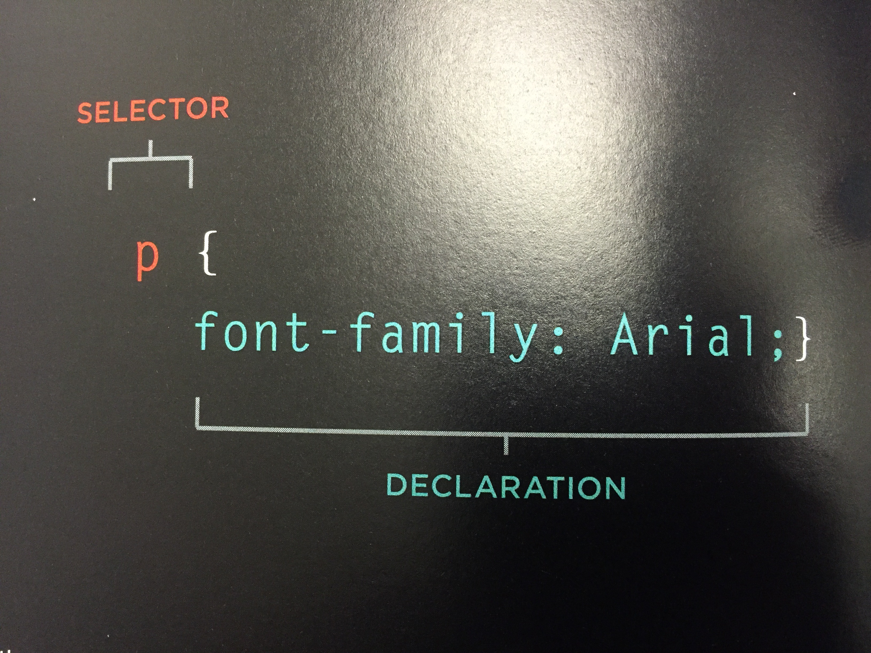
CSS
A rule is made up of a selector and a declaration.
Notes:
Selector: tells you which element the rule applies to.
Declaration: tells you how the element should be styled.

Slide 26
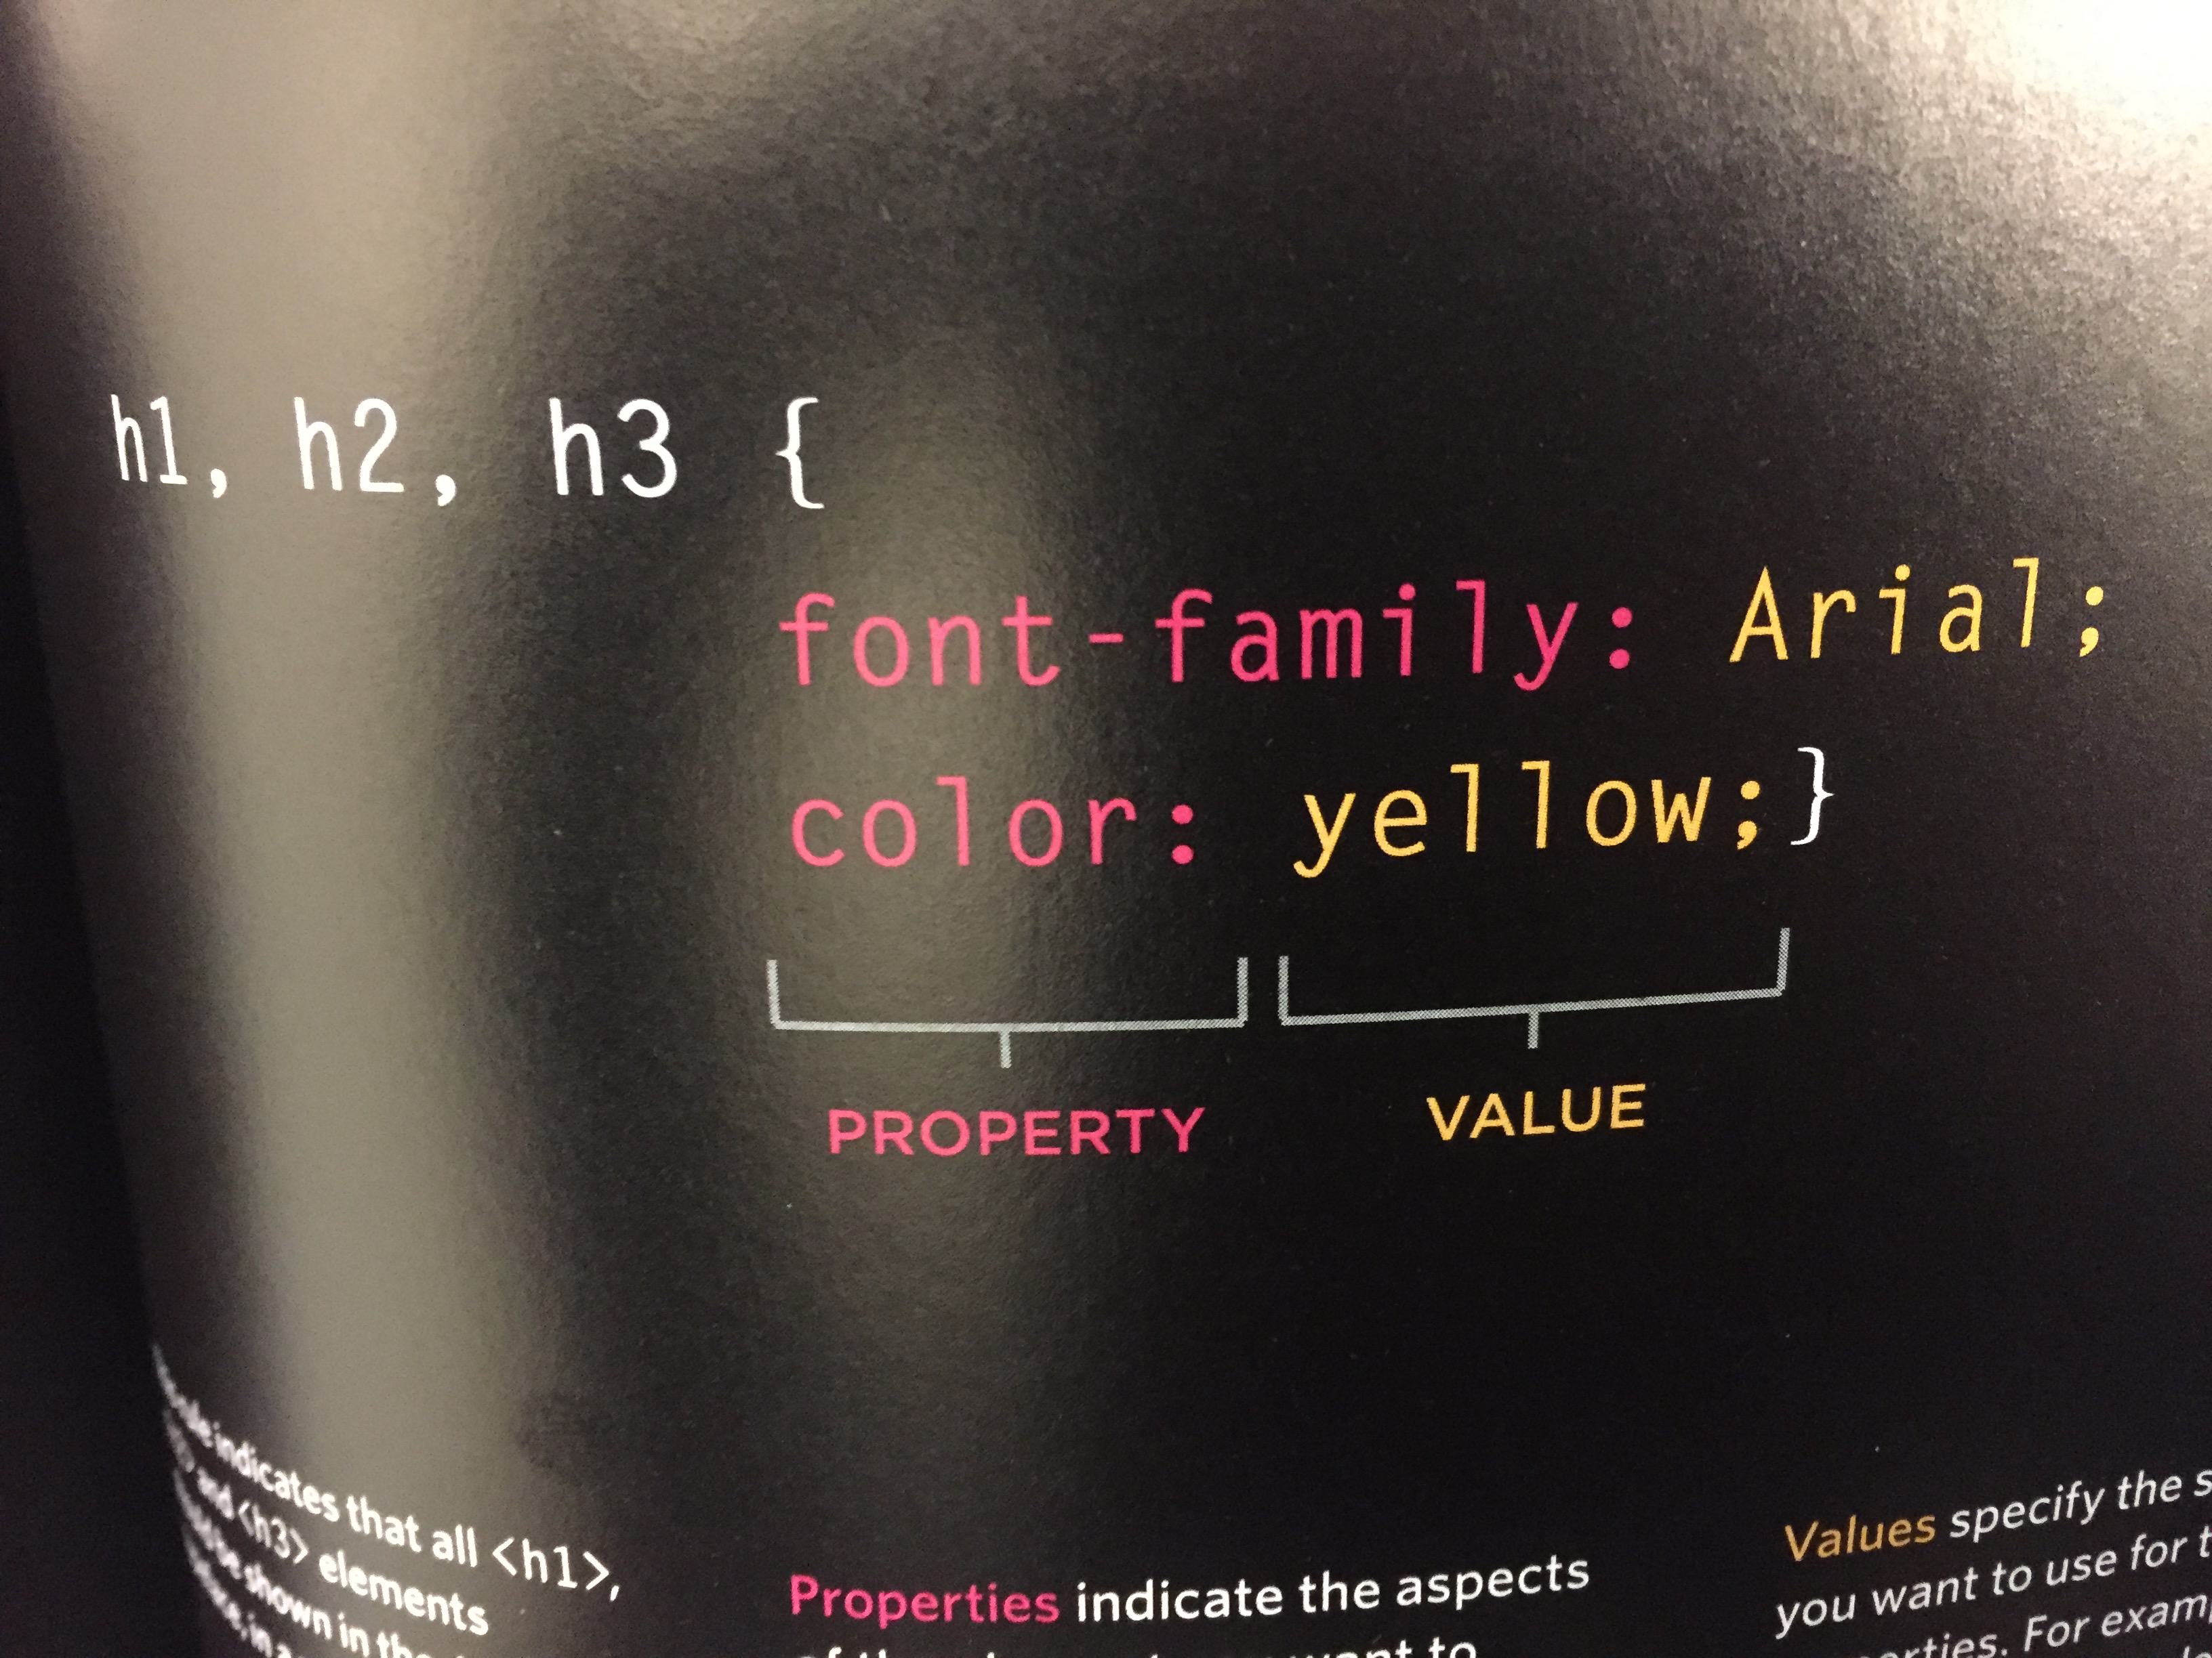
CSS
A declaration is made up of a property and a value.
Notes:
Property: refers to the aspect of the element that you want to change. E.g. color, font, width, border
Value: the setting you want to use for that property. E.g. red, monospace, 100%, thick

Slide 27
CSS Rules
Rules can be made for specific elements using their ids (# in front of selector)
#idname { … }
Or they can be made for all of a certain type of element using their name (nothing required in front of selector)
body { … }

Slide 28
CSS Rules
We can also make rules for something called a class. A class is just another attribute you give an element to identify it, kind of like a label for grouping different elements together.
A CSS rule for a class will have a period in front of it.
.thisclass { … }

Slide 29
CSS Rules
Example:
(HTML) <div class=“page”> <h1>Potatoes</h1> <p>There are so many types of potatoes.</p> </div>
(CSS) .page { border: 1px solid; background-color: #efefef; }

Slide 30
CSS Rules
Once you know how to write a CSS rule, you can just keep learning what declarations to use (and how) on different elements!

Slide 31
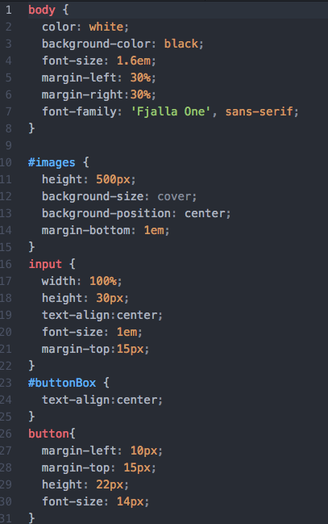

Slide 32
Huddle
Block & Inline Elements
About CSS
CSS Style Precedence
Style a Sample Page
Notes:
Any questions?

Slide 33
CSS Style Precedence
Notes:
Sometimes, CSS rules overlap on the same element or elements. Browsers use precedence rules to sort out which rule should really be used in those situations.

Slide 34
CSS Style Precedence
You’re going to teach us (yes, you read that right) which CSS rules are most important in conflict situations.

Slide 35
try{teachTheClass();}
…
halfTheClass[0]= “Last Rule”;
halfTheClass[1]= “Specificity”;
…
teacher[0] = “Important”;
teacher[1] = “Inheritance”;
(Questions on the next slide)
Notes:
We’ll go over the student questions, then give you time to work. As you figure out what’s going on, you can ask the person next to you if they found the same thing.

Slide 36
try{teachTheClass();}
“Last Rule”:
Make two CSS rules that apply to the same selector, but give them different values.
What happens on the page? What rule can you come up with from this?
Notes:
When selectors are identical, the rule that comes later will take precedence.

Slide 37
try{teachTheClass();}
“Specificity”:
Make one CSS rule that applies to multiple elements on a page (e.g., to a certain tag).
Then, make another that applies to just one of those elements (e.g., to a specific id or class).
What happens on the page? What rule can you come up with from this?
Notes:
The more specific rule will take precedence.

Slide 38
try{teachTheClass();}
“Importance”:
Putting !important after a value shows that it should take precedence over other rules that apply to the same element.
div p { font-size: 14px !important; }
Notes:
The more specific rule will take precedence.

Slide 39
try{teachTheClass();}
“Inheritance”:
An inherited property is one that is automatically applied to an element because it has already been applied to a parent element (the element that contains it).
Example: specifying font-family and color properties on <body> makes them apply to most child elements.
Notes:
“The element that contains it”: you can see this on developer tools, when you mouse over elements in the console.

Slide 40
try{teachTheClass();}
“Inheritance” (continued):
If you want an element to inherit a property from its parent that it wouldn’t normally inherit, use the value inherit.
.page { border: 1px solid #665544; background-color: #efefef; padding: inherit; }

Slide 41

Time Remaining: 5 mins
Notes:
Student break

Slide 42
Huddle
Block & Inline Elements
About CSS
CSS Style Precedence
Style a Sample Page
Notes:
Any questions?

Slide 43
Style a Sample Page

Slide 44
try{styleSamplePage();}
We will project a sample page on the board.
Your goal, in teams of three, is to replicate the page as closely as possible.
We will give you a list of the properties that you must use.
You have 30 minutes, followed by 10 minutes to present.

Slide 45
try{styleSamplePage();}
Selectors: body{} h1, h2, h3, a {} h1{} h2{} h3{} p{} p.intro:first-line{} .credits{} a{} a:hover{}
Declarations: color: #0088dd; color: #665544; font-weight: normal; font-weight: bold; font-style: italic; margin: 0px; font-size: 250%; font-size: 150%; font-size: 90%; text-align: right; text-transform: uppercase; letter-spacing: 0.2em; line-height: 1.4em; text-shadow: 2px 2px 3px #666666; text-decoration: none; text-decoration: underline; padding: 20px; padding-bottom: 10px;
Notes:
If finished with this, two options:
-recreate page, but this time start with no HTML.
-Try creating (or studying) the chapter 11 example. http://www.htmlandcssbook.com/code-samples/chapter-11/example.html

Slide 46
finally{
talkAboutWhatWe’veLearned();
}
Notes:
Discuss the topics covered:
Topics: div, span, CSS
New Processes: (link CSS page to HTML document)
Overall:
-What went well?
-What could have gone better?
-What will do we to improve?

Slide 47
Now We’re Done
Block & Inline Elements
About CSS
CSS Style Precedence
Style a Sample Page
At least… by our definition of done.

